Slide 1
Stride Funding Independent Study
By: Corey Beck, Seth Markarian, Sena Yevenyo, & Jennifer Zhu

Slide 2
Presentation Overview
Problem Statement
Data Sets
CIP SOC Crosswalk
School Specific Data Collection
Implementation
Python <- Fuzzy matching
postgreSQL <- Database
FastAPI <- Crosswalk API

Slide 3
Problem Statement
Identifying and documenting a set of one of more robust methodologies that can provide reliable and tractable connections between DOE (Department of Education) field of study classifications (CIP codes) and BLS (Bureau of Labor Statistics)/Census/Department of Labor classifications of occupations (SOC codes).
Notes:
Corey

Slide 4
Data Sets
To make connections between CIP codes and SOC codes we utilized two different sets of data.
Official DOE and BLS crosswalk
School specific ‘First Destination’ data
Notes:
Jennifer

Slide 5
DOE/BLS Crosswalk
The CIP SOC Crosswalk is a joint effort by the DOE and BLS which matches 6-digit 2020 CIP codes with 6-digit detailed descriptions from the 2018 SOC codes. The matches are based on the content of the CIP Code and SOC Code descriptions.
Notes:
Jennifer (Corey)

Slide 6
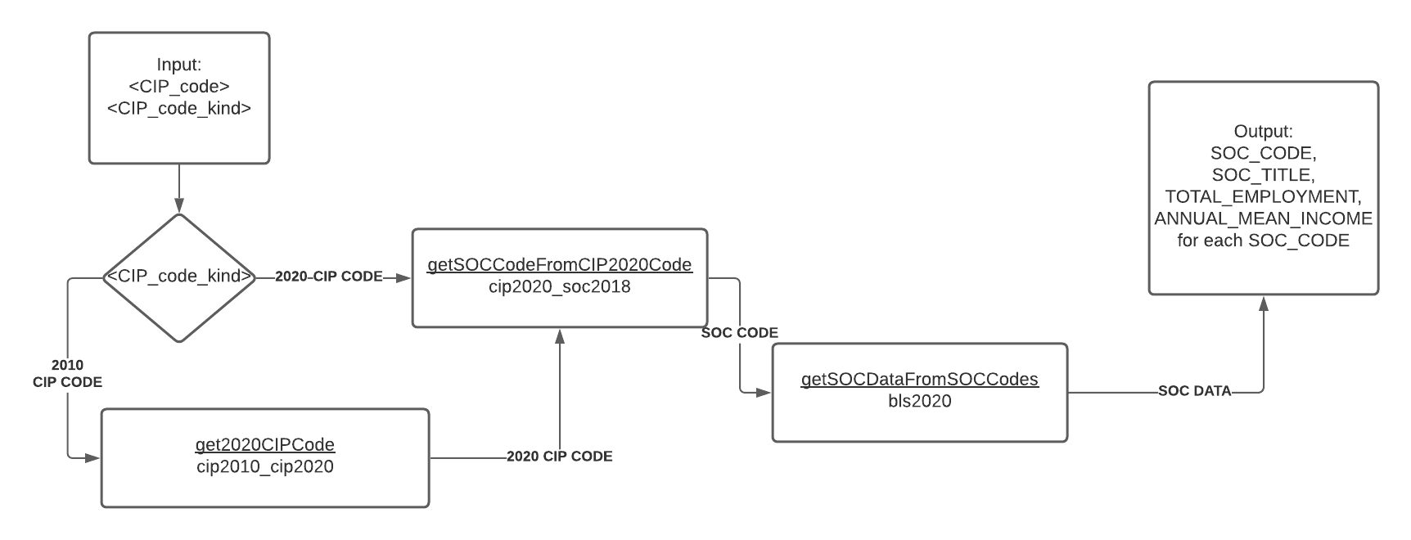
DOE/BLS Crosswalk Connections
Notes:
Corey(?)

Slide 7
School Specific Data Collection
We collected ‘First Destination’ data from the following schools, to find matchings between listed majors, and job titles. Schools were chosen to have variation in size and type, as well as having detailed enough data to create a CIP to SOC matching.
Brown University
Davidson College
Georgia Institute of Technology
Haverford College
Northeastern University
The Ohio State University
Yale University
Notes:
Jennifer

Slide 8
School Specific Data Improvements
School specific data gives the proportion of students in each SOC code, for a given CIP code.
Different types of schools may have different rates or possible SOC outcomes for a given CIP code.
School specific data can help reinforce and confirm the connections made in the CIP SOC crosswalk.
Notes:
Corey

Slide 9
Compiling data into a single database: stride_db
bls2020 - Stores the SOC/OCC data including total employed, annual mean compensation etc.
bls2020description - Stores the description of the column names of the SOC data
cip2010_cip2020 - Stores the data for conversion of CIP 2010 data into CIP 2020 data.
cip2020_soc2018 - Stores the many-to-many relation between the CIP and SOC data
school_career_outcomes - Stores the data on the crosswalk between school reported fields of occupation and the BLS SOC data
Notes:
used psql
Pros: storage space, easy integration with python

Slide 10
Implementation of CIP-SOC Crosswalk
The algorithm was implemented in Python
Lots of libraries to support database connection and data manipulation
A single change to the algorithm when implemented: 1. Any CIP code in format XX, like 01 matches with any CIP code in format 01.XXXX. eg: 01.0201 2. Any CIP code in format XX.XX like 01.01 matches with any CIP code in format 01.01XX. eg: 01.0102
Notes:
Sena

Slide 11
Use DoE and BLS data to connect job names to SOC names using fuzzy matching techniques:
Name matching
Ngrams matching
soundex/metaphone
TF-IDF
Notes:
Name- direct name connection, 60% match
Ngrams - Tri-grams by letters, 73% match
soundex/metaphone- using letter sounds to match names 79% match
TF-IDF- uses term and inverse term frequency to match, 84% match

Slide 12
Create an API using FastAPI to help with CIP lookup and SOC matching
Endpoints:
`/api/cip/{cip_code}/`
`/api/cip/{cip_code}/soc/`
`/api/soc/{soc_code}/`
Notes:
Sena

Slide 13
User Interface for the Crosswalk
Implemented using Bootstrap with the FastAPI backend
Supports entering the CIP code and retrieving a tabular dataset of the SOC matches together with the information about the CIP code
Notes:
Sena

Slide 14
Acknowledgements
Stride Funding
Dyer Center
Professors Liew and Gaugler

